Slide 1
Relational Algebra Operations & Extended Relational Algebra Operations
Chapter - 4

Slide 2
Outline
Relational Algebra
  Unary Relational Operations
  Relational Algebra Operations From Set Theory
  Binary Relational Operations
  Additional Relational Operations
  Examples of Queries in Relational Algebra

Slide 3
Relational Algebra -Overview
Relational algebra is the basic set of operations for the relational model
These operations enable a user to specify basic retrieval requests (or queries)
The result of an operation is a new relation, which may have been formed from one or more input relations
  This property makes the algebra “closed” (all objects in relational algebra are relations)
The algebra operations thus produce new relations
  These can be further manipulated using operations of the same algebra
A sequence of relational algebra operations forms a relational algebra expression
  The result of a relational algebra expression is also a relation that represents the result of a database query (or retrieval request)

Slide 4
Relational Algebra Overview
Relational Algebra consists of several groups of operations
  Unary Relational Operations
    SELECT (symbol: σ (sigma))
    PROJECT (symbol: π (pi))
    RENAME (symbol: ρ (rho))
  Relational Algebra Operations From Set Theory
    UNION ( ∪ ), INTERSECTION ( ∩ ), DIFFERENCE (or MINUS, – )
    CARTESIAN PRODUCT ( x )
  Binary Relational Operations
    JOIN (several variations of JOIN exist)
    DIVISION
  Additional Relational Operations
    OUTER JOINS, OUTER UNION
    AGGREGATE FUNCTIONS (These compute summary of information: for example, SUM, COUNT, AVG, MIN, MAX)

Slide 5

Relational Schema – COMPANY Database

Slide 6
Unary Relational Operations: SELECT
The SELECT operation (denoted by σ (sigma)) is used to select a subset of the tuples from a relation based on a selection condition
  The selection condition acts as a filter
  Keeps only those tuples that satisfy the qualifying condition
  Tuples satisfying the condition are selected whereas the other tuples are discarded (filtered out)
  The SELECT operation can also be visualized as a horizontal partition of the relation into two sets of tuples
    those tuples that satisfy the condition and are selected, and those tuples that do not satisfy the condition and are discarded
Examples:
  Select the EMPLOYEE tuples whose department number is 4:
σ _{DNO = 4} (EMPLOYEE)

Slide 7
Unary Relational Operations: SELECT
  Select the employee tuples whose salary is greater than $30,000
σ _{SALARY > 30,000} (EMPLOYEE)
In general, the select operation is denoted by
σ _{<selection condition>}(R)
where
    the symbol σ (sigma) is used to denote the select operator
    the selection condition (made of a number of clauses) is a Boolean (conditional) expression specified on the attributes of relation R
      <attribute name> <comparison op> <constant value> (or)
      <attribute name> <comparison op> <attribute name>
    where
      <attribute name> is the name of an attribute of R,
      <comparison op> is normally one of the operators {=, <, ≤, >, ≥, ≠}, and
      <constant value> is a constant value from the attribute domain

Slide 8
Unary Relational Operations: SELECT
    Clauses can be connected by the standard Boolean operators and, or, and not to form a general selection condition
For example : To select the tuples for all employees who either work in department 4 and make over $25,000 per year, or work in department 5 and make over $30,000, we can specify the following SELECT operation:
  tuples that make the condition true are selected
      appear in the result of the operation
  tuples that make the condition false are filtered out
      discarded from the result of the operation

Slide 9
Unary Relational Operations: SELECT
The SELECT operator is unary; that is, it is applied to a single relation
The selection operation is applied to each tuple individually
The degree of the relation resulting from a SELECT operation-its number of attributes-is the same as the degree of R
The number of tuples in the resulting relation is always less than or equal to the number of tuples in R, for any condition c

Slide 10
Unary Relational Operations: SELECT
SELECT Operation Properties
  The SELECT operation σ _{<selection condition>}(R) produces a relation S that has the same schema (same attributes) as R
  SELECT σ is commutative
    σ _{<condition1>}(σ _{< condition2>} (R)) = σ _{<condition2>} (σ _{< condition1>} (R))
  Because of commutativity property, a cascade (sequence) of SELECT operations may be applied in any order
    σ_{<cond1>}(σ_{<cond2>} (σ_{<cond3>} (R)) = σ_{<cond2>} (σ_{<cond3>} (σ_{<cond1>} ( R)))
  A cascade of SELECT operations may be replaced by a single selection with a conjunction of all the conditions
    σ_{<cond1>}(σ_{< cond2>} (σ_{<cond3>}(R)) = σ <cond1> AND < cond2> AND < cond3>(R)))
  The number of tuples in the result of a SELECT is less than (or equal to) the number of tuples in the input relation R

Slide 11


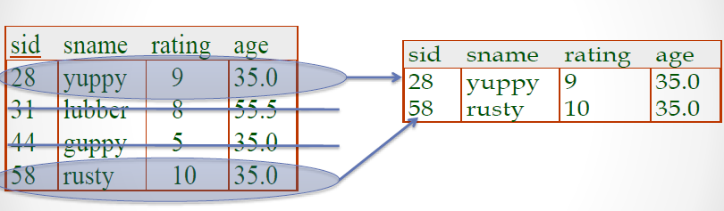
Unary Relational Operations: SELECT
Selects rows that satisfy selection condition

Slide 12
Unary Relational Operations: PROJECT
The SELECT operation - chooses some of the rows from the table while discarding other rows.
The PROJECT operation - selects certain columns from the table and discards the other columns.
  If we are interested in only certain attributes of a relation, we use the PROJECT operation to project the relation over these attributes only
The result of the PROJECT operation can be visualized as a vertical partition of the relation into two relations
    The list of specified columns (attributes) is kept in each tuple
    The other attributes in each tuple are discarded
PROJECT Operation - denoted by π (pi)

Slide 13
Unary Relational Operations: PROJECT
Example: To list each employee’s first and last name and salary, the following is used
  π_{LNAME, FNAME,SALARY}(EMPLOYEE)
The general form of the project operation is:
π_{<attribute list>}(R)
  π (pi) is the symbol used to represent the project operation
  <attribute list> is the desired list of attributes from relation R
The project operation removes any duplicate tuples
  This is because the result of the project operation must be a set of tuples
  If duplicates are not eliminated, the result would be a multiset or bag of tuples rather than a set
  Mathematical sets do not allow duplicate elements

Slide 14
Unary Relational Operations: PROJECT
PROJECT Operation Properties
  The number of tuples in the result of projection π_{<list>}(R) is always less or equal to the number of tuples in R
  If the list of attributes includes a key of R, then the number of tuples in the result of PROJECT is equal to the number of tuples in R
    The result of the PROJECT operation has only the attributes specified in <attribute list> in the same order as they appear in the list. Hence, its degree is equal to the number of attributes in <attribute list>
  PROJECT is not commutative
    π _{<list1>} (π _{<list2>} (R) ) = π _{<list1>} (R) as long as <list2> contains the attributes in <list1>

Slide 15
Unary Relational Operations: PROJECT
In SQL, the PROJECT attribute list is specified in the SELECT clause of a query
For example, the following operation:
π_{Sex, Salary}(EMPLOYEE)
would correspond to the following SQL query:
SELECT DISTINCT Sex, Salary
FROM EMPLOYEE
Note : if we remove the keyword DISTINCT from this SQL query, then duplicates will not be eliminated

Slide 16
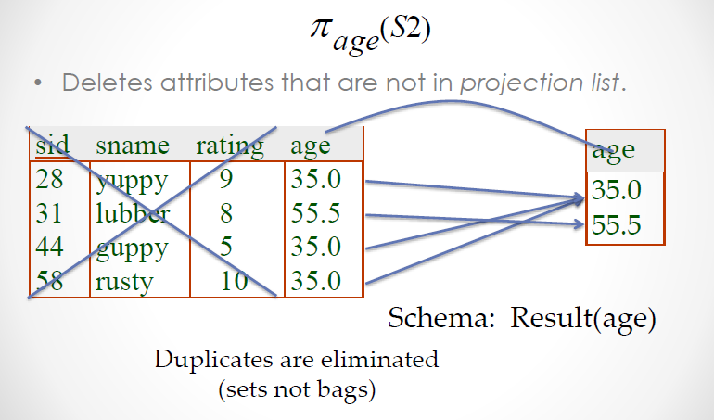
Unary Relational Operations: PROJECT

Slide 17
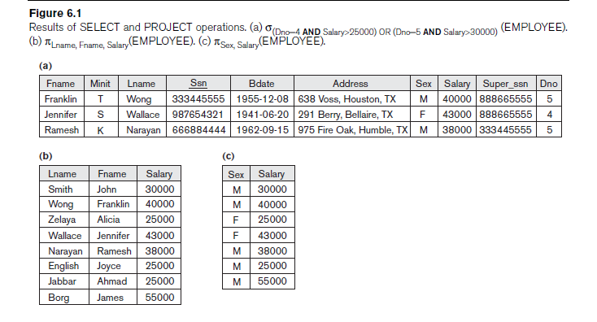
Unary Relational Operations: SELECT

Slide 18
Relational Algebra Expressions
We may want to apply several relational algebra operations one after the other
  Either we can write the operations as a single relational algebra expression by nesting the operations, or
  We can apply one operation at a time and create intermediate result relations.
In the latter case, we must give names to the relations that hold the intermediate results

Slide 19
Single expression versus sequence of relational operations (Example)
To retrieve the first name, last name, and salary of all employees who work in department number 5, we must apply a select and a project operation
We can write a single relational algebra expression as follows:
  π_{FNAME, LNAME, SALARY}(σ _{DNO=5}(EMPLOYEE))
(OR) We can explicitly show the sequence of operations, giving a name to each intermediate relation:
  DEP5_EMPS ← σ _{DNO=5}(EMPLOYEE)
  RESULT ← π _{FNAME, LNAME, SALARY} (DEP5_EMPS)

Slide 20
Unary Relational Operations: RENAME
The RENAME operator is denoted by ρ (rho)
In some cases, we may want to rename the attributes of a relation or the relation name or both
  Useful when a query requires multiple operations
  Necessary in some cases (see JOIN operation later)
The general RENAME operation ρ can be expressed by any of the following forms
    ρ_{S (B1, B2, …, Bn )}(R) changes both
    the relation name to S, and
    the column (attribute) names to B1, B1, …..,Bn
  ρ_{S}(R) changes
    the relation name only to S
  ρ_{(B1, B2, …, Bn )}(R) changes
    the column (attribute) names only to B1, B1, …..Bn

Slide 21
Unary Relational Operations: RENAME
For convenience, we also use a shorthand for renaming attributes in an intermediate relation
  If we write:
    RESULT ← π _{FNAME, LNAME, SALARY} (DEP5_EMPS)
    RESULT will have the same attribute names as DEP5_EMPS (same attributes as EMPLOYEE)
  If we write:
    RESULT (F, M, L, S, B, A, SX, SAL, SU, DNO)← π _{FNAME, LNAME, SALARY} (DEP5_EMPS)
    The 10 attributes of DEP5_EMPS are renamed to F, M, L, S, B, A, SX, SAL, SU, DNO, respectively

Slide 22
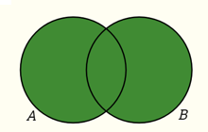
Relational Algebra Operations from
Set Theory : UNION
UNION Operation
  Binary operation, denoted by ∪
  The result of R ∪ S, is a relation that includes all tuples that are either in R or in S or in both R and S
  Duplicate tuples are eliminated
  The two operand relations R and S must be “type compatible” (or UNION compatible)
    R and S must have same number of attributes (arity)
    Each pair of corresponding attributes must be type compatible (have same or compatible domains)
Two relations R(A1, A2, ..., An) and S(B1, B2, ..., Bn) are said to be union compatible (or type compatible) if they have the same degree n and if dom(Ai) = dom(Bi) for 1 ≤i ≤ n

Slide 23
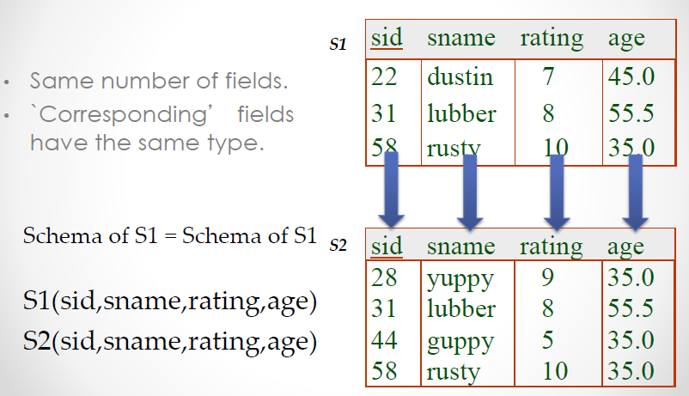
Union Compatible

Slide 24
Relational Algebra Operations from
Set Theory : UNION
Three operations UNION, INTERSECTION, and SET DIFFERENCE on two union-compatible relations R and S are defined as follows:
  UNION: The result of this operation, denoted by R ∪ S, is a relation that includes all tuples that are either in R or in S or in both R and S. Duplicate tuples are eliminated
  INTERSECTION: The result of this operation, denoted by R ∩ S, is a relation that includes all tuples that are in both R and S
  SET DIFFERENCE (or MINUS): The result of this operation, denoted by R – S, is a relation that includes all tuples that are in R but not in S

Slide 25
Relational Algebra Operations from
Set Theory : UNION
Example
  To retrieve the social security numbers of all employees who either work in department 5 (RESULT1 below) or directly supervise an employee who works in department 5 (RESULT2 below)
  We can use the UNION operation as follows:
DEP5_EMPS ← σ_{DNO=5} (EMPLOYEE)
RESULT1 ← π _{SSN}(DEP5_EMPS)
RESULT2(SSN) ← π_{SUPERSSN}(DEP5_EMPS)
RESULT ← RESULT1 ∪ RESULT2
  The union operation produces the tuples that are in either RESULT1 or RESULT2 or both

Slide 26
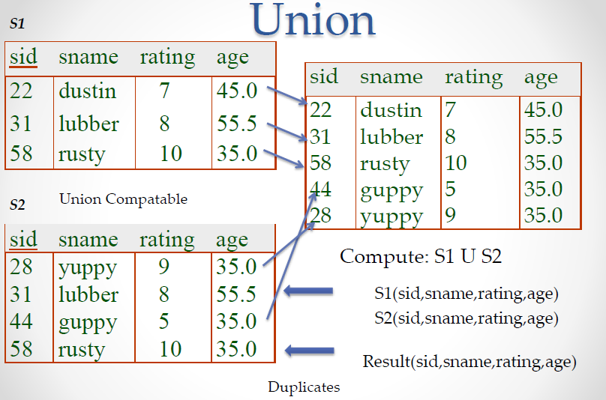
Relational Algebra Operations from
Set Theory : UNION

Slide 27
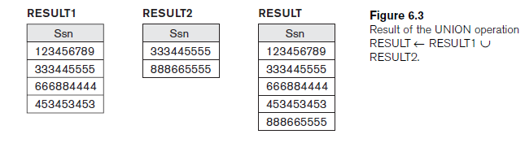
Relational Algebra Operations from
Set Theory : UNION

Slide 28
Relational Algebra Operations from
Set Theory
Type Compatibility of operands is required for the binary set operation UNION ∪, (also for INTERSECTION ∩, and SET DIFFERENCE –, see next slides)
R1(A1, A2, ..., An) and R2(B1, B2, ..., Bn) are type compatible if:
  they have the same number of attributes, and
  the domains of corresponding attributes are type compatible (i.e. dom(Ai)=dom(Bi) for i=1, 2, ..., n).
The resulting relation for R1∪R2 (also for R1∩R2, or R1–R2) has the same attribute names as the first operand relation R1 (by convention)

Slide 29
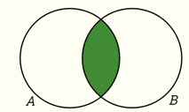
Relational Algebra Operations from Set Theory: INTERSECTION
INTERSECTION is denoted by ∩
The result of the operation R ∩ S, is a relation that includes all tuples that are in both R and S
  The attribute names in the result will be the same as the attribute names in R
The two operand relations R and S must be “type compatible”

Slide 30
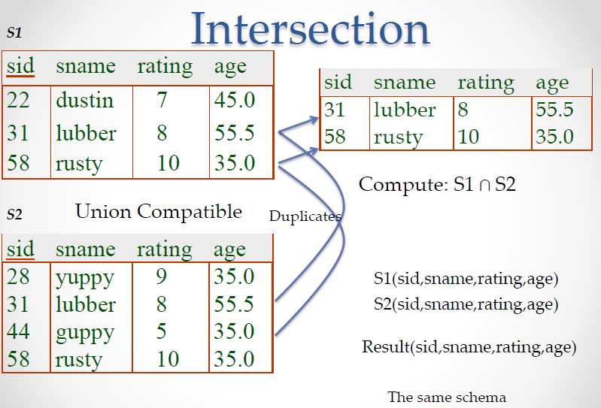
Relational Algebra Operations from Set Theory: INTERSECTION

Slide 31
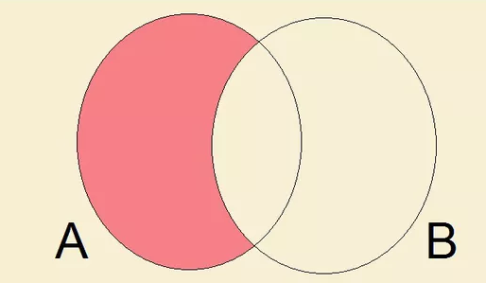
Relational Algebra Operations from Set Theory: SET DIFFERENCE
SET DIFFERENCE (also called MINUS or EXCEPT) is denoted by –
The result of R – S, is a relation that includes all tuples that are in R but not in S
  The attribute names in the result will be the same as the attribute names in R
The two operand relations R and S must be “type compatible”

Slide 32
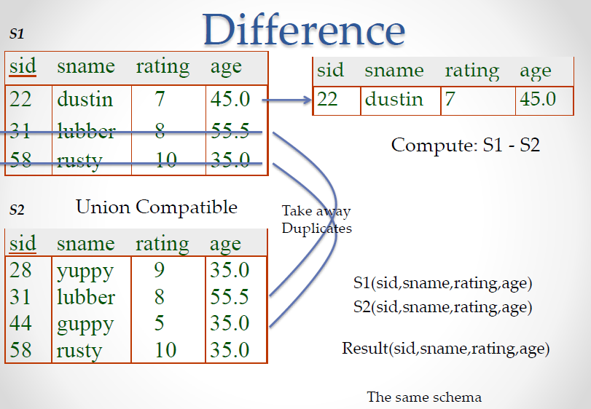
Relational Algebra Operations from Set Theory: SET DIFFERENCE

Slide 33
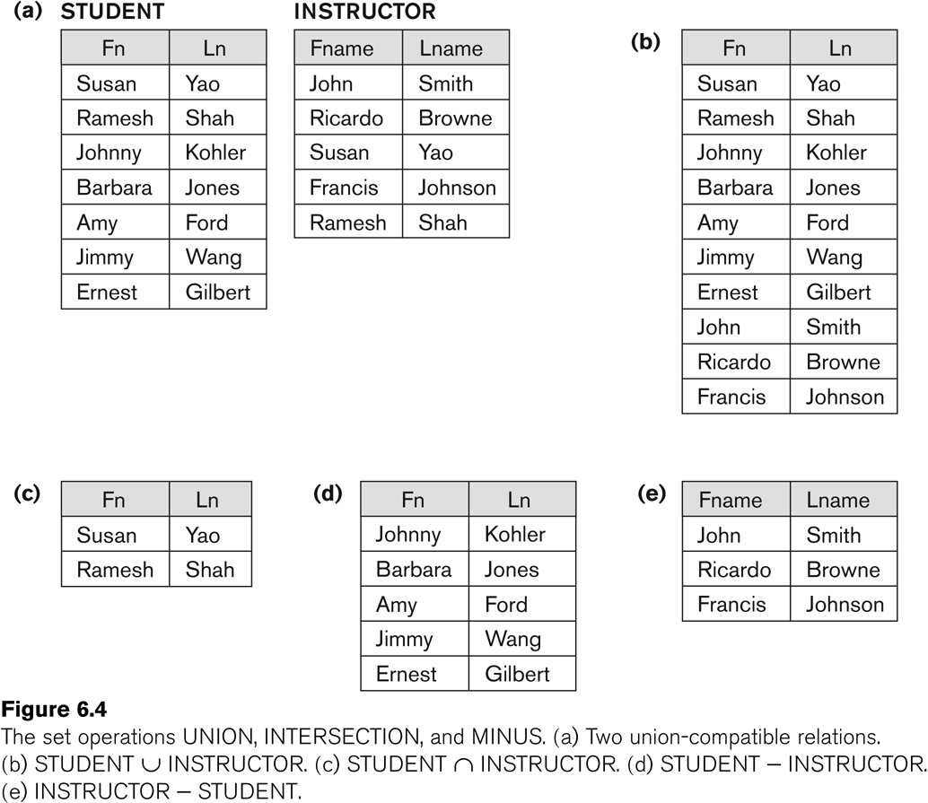
Example to illustrate the result of UNION, INTERSECT, and DIFFERENCE

Slide 34
Some Properties of UNION, INTERSECT, and DIFFERENCE
Notice that both union and intersection are commutative operations; that is
  R ∪ S = S ∪ R, and R ∩ S = S ∩ R
Both union and intersection can be treated as n-ary operations applicable to any number of relations as both are associative operations; that is
  R ∪ (S ∪ T) = (R ∪ S) ∪ T
  (R ∩ S) ∩ T = R ∩ (S ∩ T)
The minus operation is not commutative; that is, in general
  R – S ≠ S – R

Slide 35
Relational Algebra Operations from Set Theory: CARTESIAN PRODUCT
CARTESIAN (or CROSS) PRODUCT Operation
  This operation is used to combine tuples from two relations in a combinatorial fashion
  Denoted by R(A1, A2, . . ., An) x S(B1, B2, . . ., Bm)
  Result is a relation Q with degree n + m attributes
    Q(A1, A2, . . ., An, B1, B2, . . ., Bm), in that order
  The resulting relation state has one tuple for each combination of tuples—one from R and one from S.
  Hence, if R has n_{R} tuples (denoted as |R| = n_{R} ), and S has n_{S} tuples, then R x S will have n_{R} * n_{S} tuples
  The two operands do NOT have to be "type compatible”

Slide 36
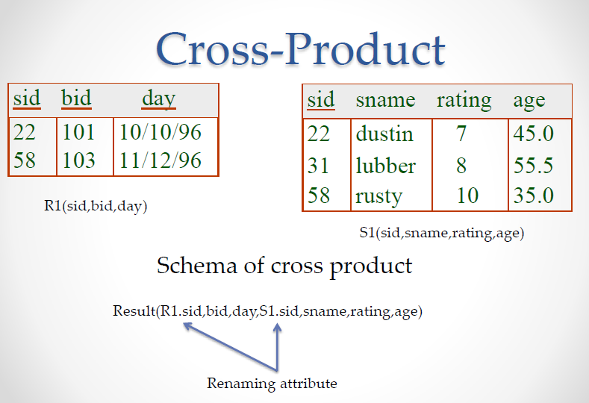
CARTESIAN PRODUCT

Slide 37
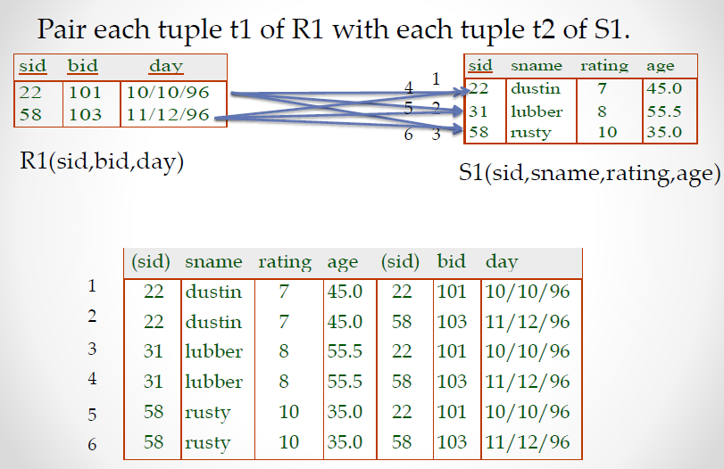
CARTESIAN PRODUCT

Slide 38
Relational Algebra Operations from Set Theory: CARTESIAN PRODUCT
Generally, CROSS PRODUCT is not a meaningful operation
  Can become meaningful when followed by other operations
Example (not meaningful)
  FEMALE_EMPS ← σ _{SEX=’F’}(EMPLOYEE)
  EMPNAMES ← π _{FNAME, LNAME, SSN} (FEMALE_EMPS)
  EMP_DEPENDENTS ← EMPNAMES x DEPENDENT
EMP_DEPENDENTS will contain every combination of EMPNAMES and DEPENDENT
  whether or not they are actually related

Slide 39
Relational Algebra Operations from Set Theory: CARTESIAN PRODUCT
To keep only combinations where the DEPENDENT is related to the EMPLOYEE, add a SELECT operation as follows
Example (meaningful)
  FEMALE_EMPS ← σ _{SEX=’F’}(EMPLOYEE)
  EMPNAMES ← π _{FNAME, LNAME, SSN} (FEMALE_EMPS)
  EMP_DEPENDENTS ← EMPNAMES x DEPENDENT
  ACTUAL_DEPS ← σ _{SSN=ESSN}(EMP_DEPENDENTS)
  RESULT ← π _{FNAME, LNAME, DEPENDENT_NAME} (ACTUAL_DEPS)
RESULT will now contain the name of female employees and their dependents

Slide 40
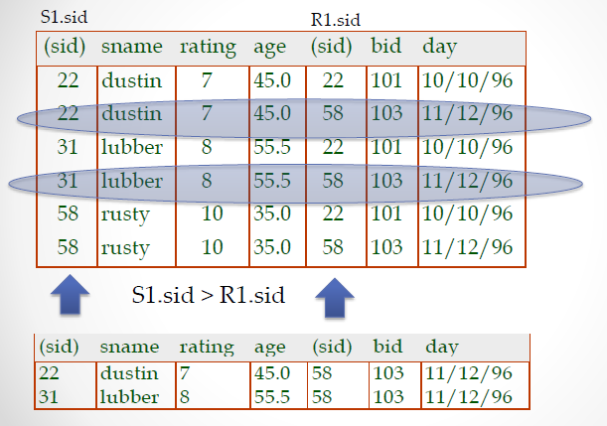
CARTESIAN PRODUCT - SELECTION

Slide 41
Binary Relational Operations: JOIN
JOIN Operation (denoted by )
  The sequence of CARTESIAN PRODECT followed by SELECT is used quite commonly to identify and select related tuples from two relations
  A special operation, called JOIN combines this sequence into a single operation
  This operation is very important for any relational database with more than a single relation, because it allows us combine related tuples from various relations
  The general form of a join operation on two relations R(A1, A2, . . ., An) and S(B1, B2, . . ., Bm) is:
  R _{<join condition>}S
  where R and S can be any relations that result from general relational algebra expressions

Slide 42
Binary Relational Operations: JOIN
Example: Suppose that we want to retrieve the name of the manager of each department
  To get the manager’s name, we need to combine each DEPARTMENT tuple with the EMPLOYEE tuple whose SSN value matches the MGRSSN value in the department tuple.
  We do this by using the join operation
  DEPT_MGR ← DEPARTMENT _{MGRSSN=SSN} EMPLOYEE
MGRSSN=SSN is the join condition
  Combines each department record with the employee who manages the department
  The join condition can also be specified as DEPARTMENT.MGRSSN= EMPLOYEE.SSN

Slide 43
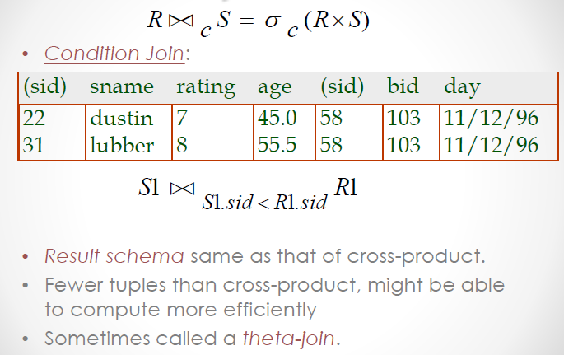
Joins

Slide 44
Some properties of JOIN
Consider the following JOIN operation:
  R(A1, A2, . . ., An) S(B1, B2, . . ., Bm)
    R.Ai=S.Bj
  Result is a relation Q with degree n + m attributes:
    Q(A1, A2, . . ., An, B1, B2, . . ., Bm), in that order.
  The resulting relation state has one tuple for each combination of tuples—r from R and s from S, but only if they satisfy the join condition r[Ai]=s[Bj]
  Hence, if R has n_{R} tuples, and S has n_{S} tuples, then the join result will generally have less than n_{R} * n_{S} tuples
  Only related tuples (based on the join condition) will appear in the result

Slide 45
Some properties of JOIN
The general case of JOIN operation is called a Theta-join: R S
    theta
The join condition is called theta
Theta can be any general boolean expression on the attributes of R and S;
  For example
  R.Ai<S.Bj AND (R.Ak=S.Bl OR R.Ap<S.Bq)
Most join conditions involve one or more equality conditions “AND”ed together;
  For example:
  R.Ai=S.Bj AND R.Ak=S.Bl AND R.Ap=S.Bq

Slide 46
Binary Relational Operations: EQUIJOIN
The most common use of join involves join conditions with equality comparisons only
Such a join, where the only comparison operator used is =, is called an EQUIJOIN
  In the result of an EQUIJOIN we always have one or more pairs of attributes (whose names need not be identical) that have identical values in every tuple
Special case of condition join where the condition c contains only equalities
Result schema similar to cross-product
  but only one copy of fields for which equality is specified

Slide 47
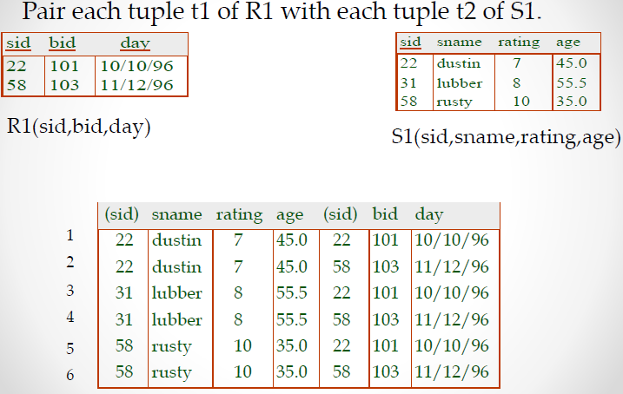
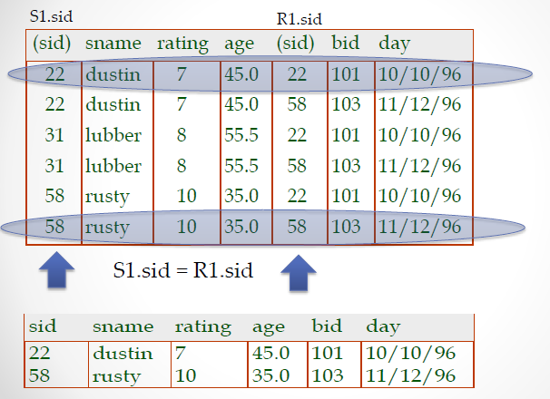
EQUIJOIN

Slide 48
Binary Relational Operations:
NATURAL JOIN Operation
Another variation of JOIN called NATURAL JOIN — denoted by * — was created to get rid of the second (superfluous) attribute in an EQUIJOIN condition.
    because one of each pair of attributes with identical values is superfluous
  The standard definition of natural join requires that the two join attributes, or each pair of corresponding join attributes, have the same name in both relations
  If this is not the case, a renaming operation is applied first

Slide 49
Binary Relational Operations :
NATURAL JOIN
Example: To apply a natural join on the DNUMBER attributes of DEPARTMENT and DEPT_LOCATIONS, it is sufficient to write:
  DEPT_LOCS ← DEPARTMENT * DEPT_LOCATIONS
Only attribute with the same name is DNUMBER
An implicit join condition is created based on this attribute:
  DEPARTMENT.DNUMBER=DEPT_LOCATIONS.DNUMBER
Another example: Q ← R(A,B,C,D) * S(C,D,E)
  The implicit join condition includes each pair of attributes with the same name, “AND”ed together:
    R.C=S.C AND R.D.S.D
  Result keeps only one attribute of each such pair:
    Q(A,B,C,D,E)

Slide 50
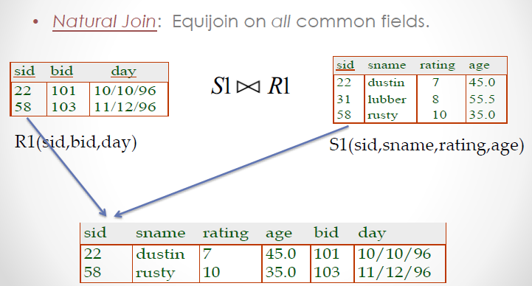
Natural Join

Slide 51
Complete Set of Relational Operations
The set of operations including SELECT σ, PROJECT π , UNION ∪, DIFFERENCE − , RENAME ρ, and CARTESIAN PRODUCT X is called a complete set because any other relational algebra expression can be expressed by a combination of these five operations
For example
  R ∩ S = (R ∪ S ) – ((R − S) ∪ (S − R))
  R _{<join condition>}S = σ _{<join condition>} (R X S)

Slide 52
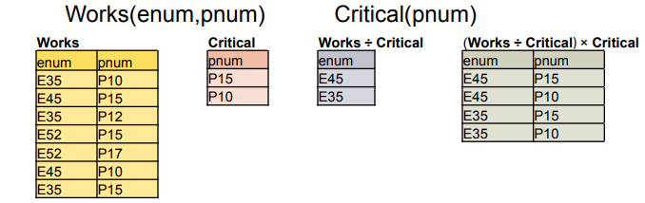
Binary Relational Operations: DIVISION
Binary operator - R ÷ S
Attributes of S must be a subset of the attributes of R
attr(R ÷ S) = attr(R) – attr(S)
t tuple in (R ÷ S) iff (t × S) is a subset of R
Used to answer questions involving all
  e.g., Which employees work on all the critical projects?
  “Inverse” of cross product

Slide 53


Binary Relational Operations: DIVISION
The DIVISION operation - useful for a special kind of query that sometimes occurs in database applications
Example - Retrieve the names of employees who work on all the projects that ‘John Smith’ works on

Slide 54
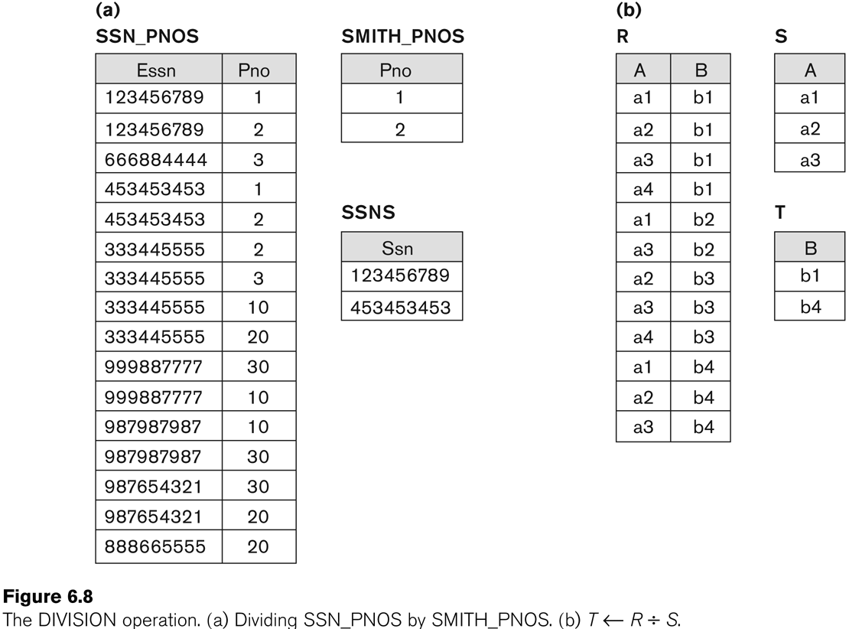
Example of DIVISION

Slide 55
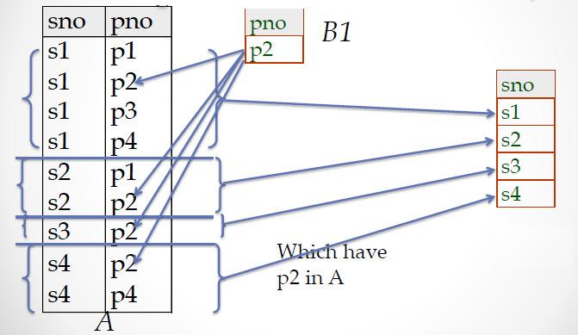
Binary Relational Operations: DIVISION
A B1

Slide 56
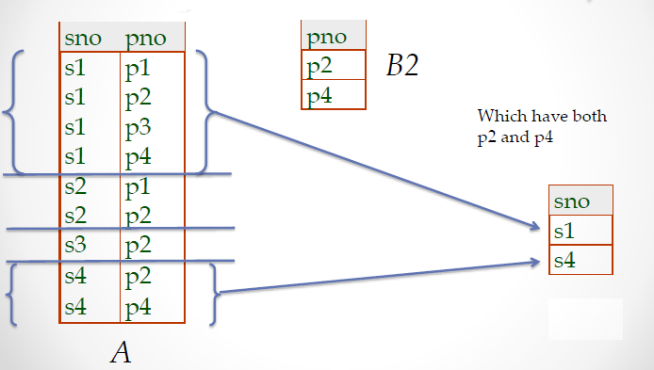
Binary Relational Operations: DIVISION
A B2

Slide 57
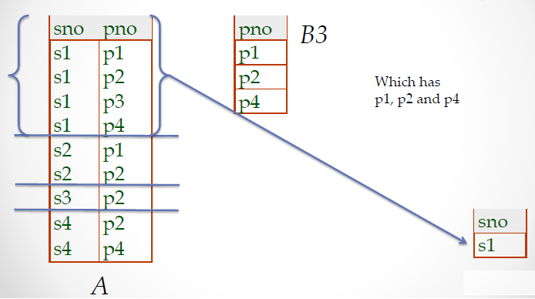
Binary Relational Operations: DIVISION
A B3

Slide 58
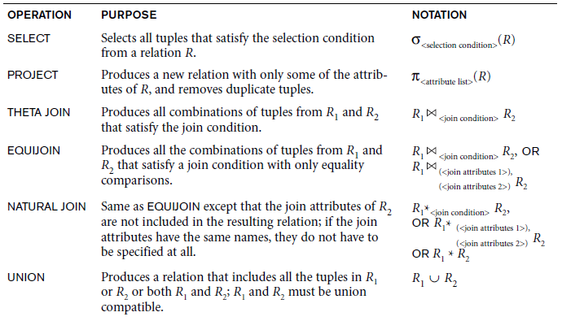
Recap of Relational Algebra Operations

Slide 59
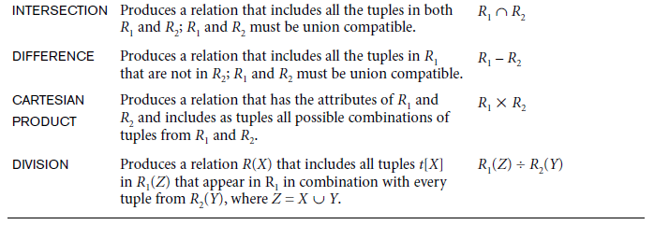
Recap of Relational Algebra Operations

